Slide 1
Career readiness for student
Resume Writing, Interview Skills, and Personal Branding

Slide 2
UNDERSTANDING THE RESUME : basics
First things first! Be crystal clear on what a resume is and what purpose is it going to serve.
The resume is a well presented 1-2 page summary of your background and credentials.
The sole purpose of your resume is to effectively sell your credentials for the purpose of employment, admission to Universities, consideration for a scholarship or fellowship, or other professional purposes.
If you're seeking employment you must know:
Your resume is to get you an interview, not a job!
Your resume will be screened by an employer for just 15-20 seconds. That's all the time your resume has to make an impact!

Slide 3
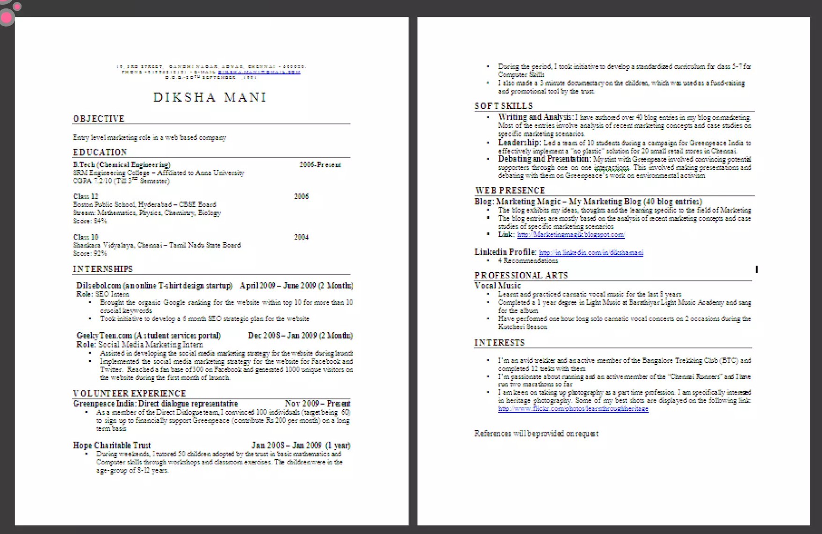

Slide 4
UNDERSTANDING THE RESUME: SECTIONS
These are the different sections that will go into your resume They will appear on your resume in the same order ax mentioned here
Section : What is the employer looking for
1.Header : Your identity and to contact you
2.Objective :To check if their requirement and your objective match
3.Education :To check if you have the basic qualification for the job/ internship you are applying for
4.Practical Experience/ Projects : To see if you have done anything that reflects your potential capability. Also, to see how different are you from your peers.

Slide 5
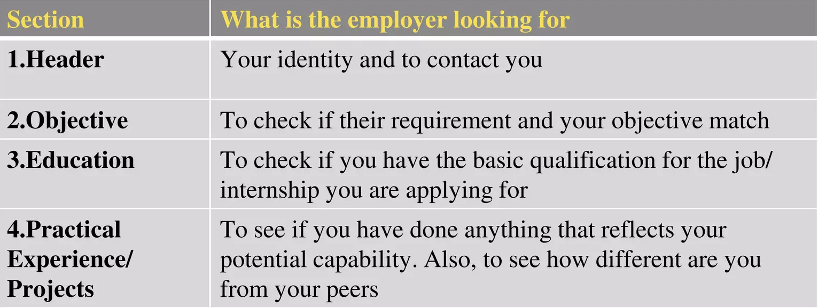

Slide 6
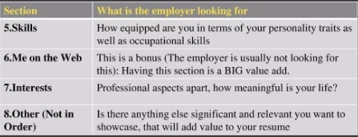

Slide 7
STEP 1 PREPARATORY WORK & IMPORTANT TIPS
A little preparation before you start will make your resume making process convenient and quicker. Here is a quick checklist
Educational documents from class 10 onwards to calculate scores
Make a list of all things that you want to add on your resume. Like internships, projects, part-time jobs, extra-curricular activities, sports. trainings, skills, interests, ete. The list does not need to be exhaustive, you can always add to the list as you go

Slide 8
Step 1 to step 10 guide

Slide 9
STEP 1 PREPARATORY WORK & IMPORTANT TIPS
TOP MUST-FOLLOW TIPS BEFORE YOU START
SPECIFIC POINTS - Every point on your resume must be specific and must be supported be numbers or tangible/factual information
Use ACTION VERBS (list given on page 39 onwards) in all your points They catch attention immediately and make your sentences clear.
Use BULLET POINTS, make them crisp NO paragraphs
DO NOT mention your "responsibilities" mention what you've accomplished A Common mistake most of us make while constructing a resume is to copy the format from a friend's resume and build it based on that. AVOID THIS, unless your friend has taken professional help on making a resume.

Slide 10
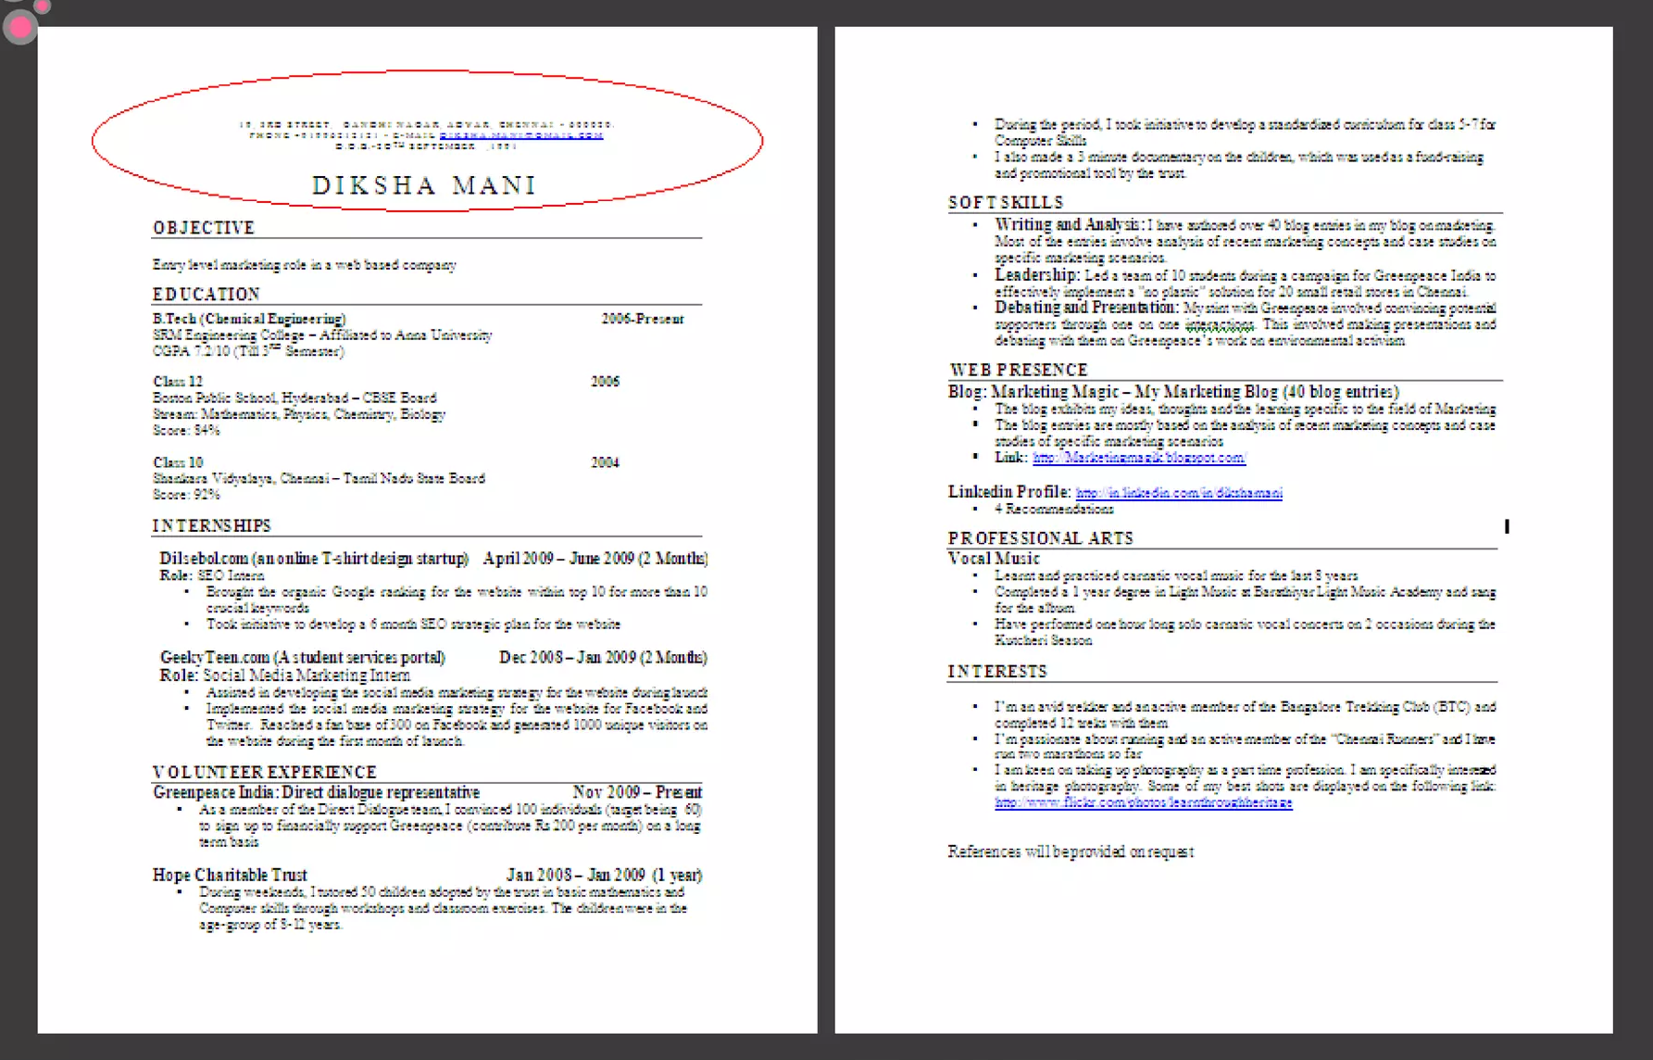

Slide 11
STEP 2 RESUME HEADER
Here we go! Lets start with what goes on the top of your resume
Purpose
You need to give some basic information about yourself, mainly so that they can contact you.
Guidelines
Fields to include: Name, Current address, email id, phone number, date of Birth (optional) Write your name in a bigger font (also make it bold) than the other text
Do not
Do Not Include your photo
Do Not write "Resume" as a heading to the file
Do not give unnecessary details like family information, marital status, etc.
Do not add these details at the bottom of your resume. Do not occupy much space to fill up these details

Slide 12
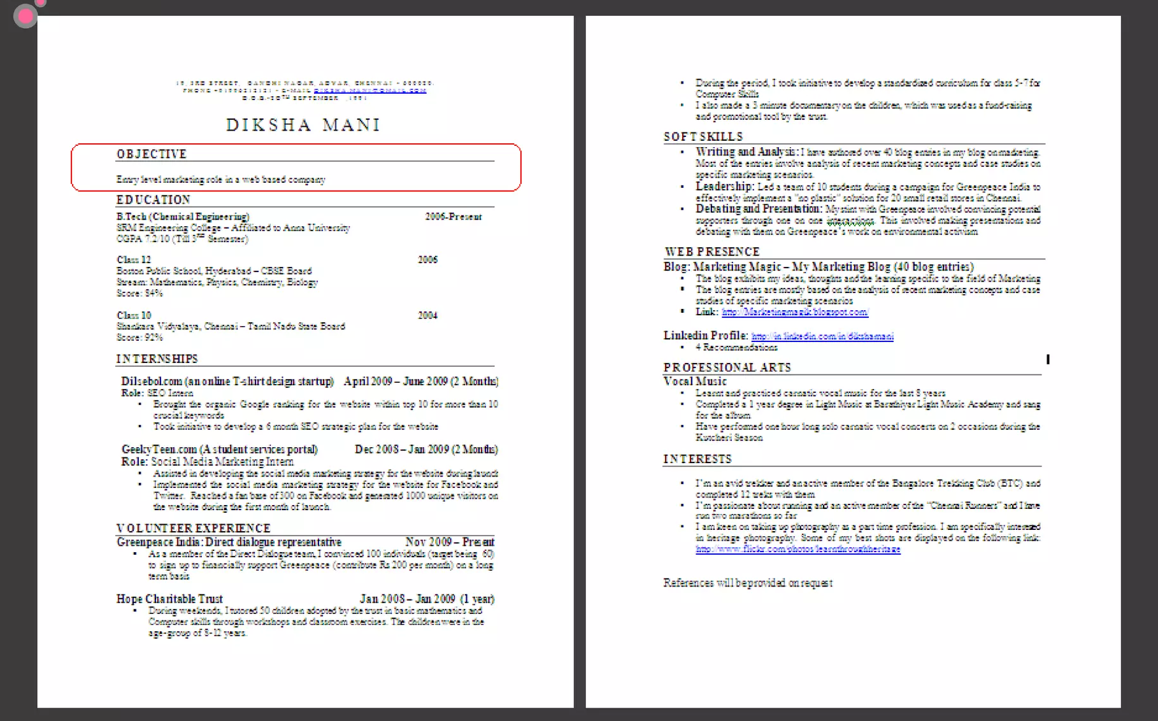

Slide 13
STEP 3 FRAMING THE OBJECTIVE
Your Objective is the first thing an employer sees on your resume
Heading on Resume: Objective
Purpose
To convey to your employer what your goal is. It should be aimed towards getting a particular position in a specific industry
Guidelines
• Your objective should include the following:
Position wanted
Functional area
Industry wanted
• Be specific and crisp. Restrict it to 15 words.
• Your objective will be different for each role you apply to
• Keep the Employer's requirement in mind while writing the objective! The objective is not about what you desire from the company, its about the company's need

Slide 14
STEP 3 FRAMING THE OBJECTIVE
Examples
If you are a job seeker:
1. Entry level programmer in a software development company.
2.A position as a trainee in a petro-chemical company
If you are seeking an internship:
1.Intern in a marketing role in a web startup
Do not
BIG NO to generic/vague objectives. They are a big turn off.
Here is a bad example:
To work for an organization that provides an environment to grow as a professional and the opportunity to add value to the organization through meaningful roles.

Slide 15
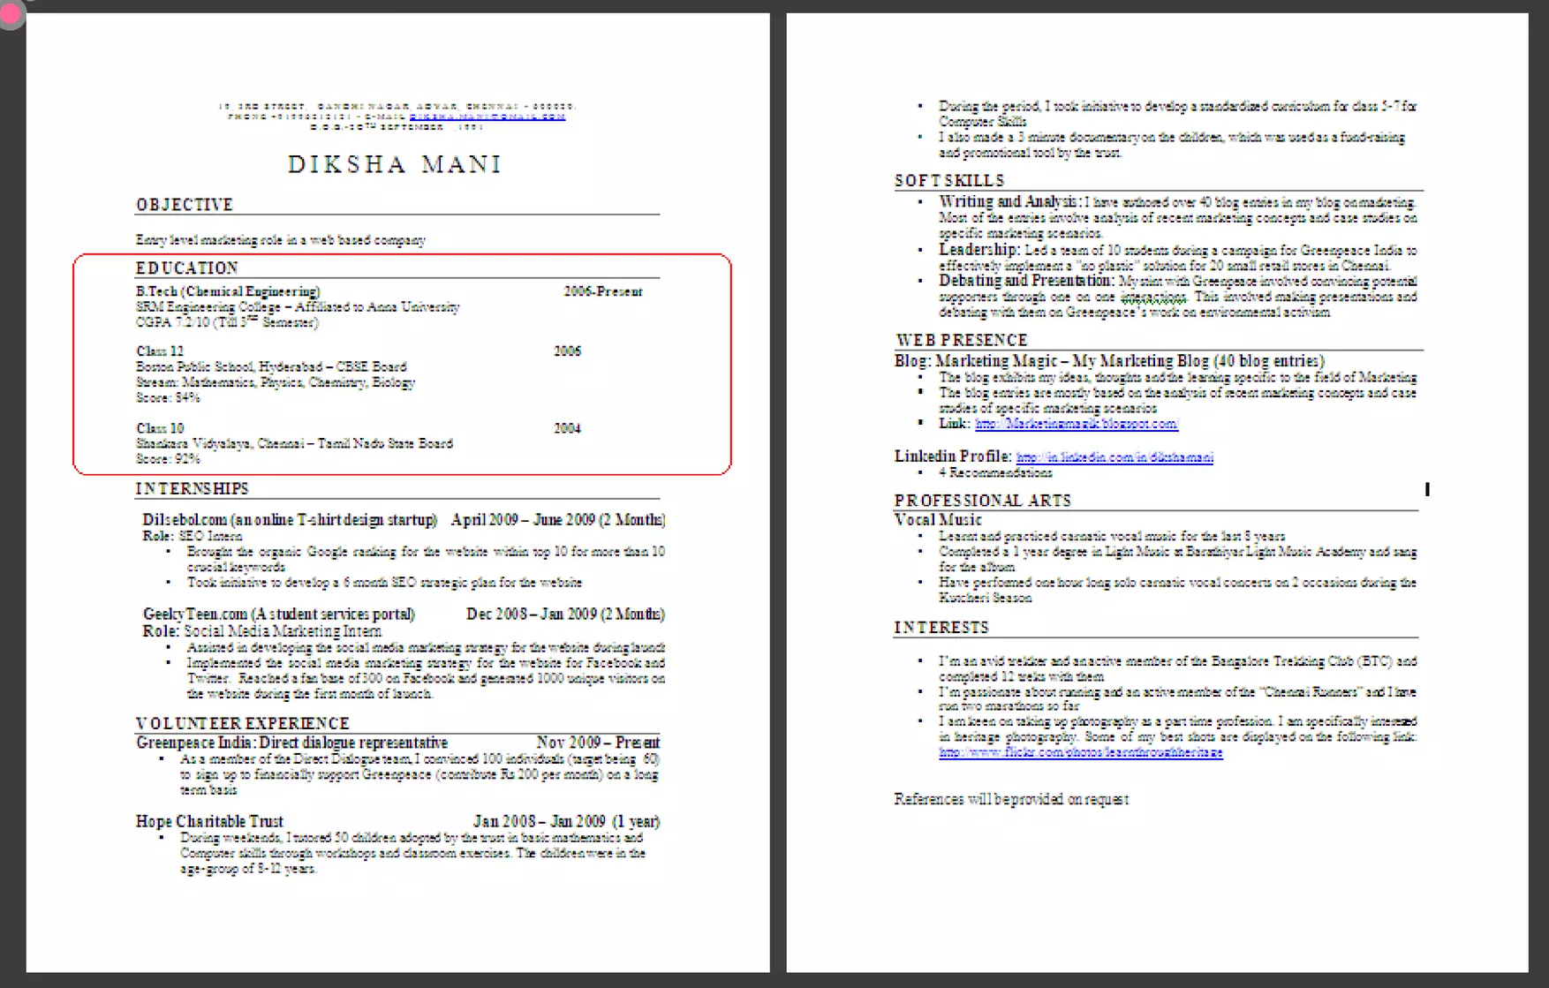

Slide 16
STEP 4 EDUCATION
The next section in your resume is to highlight your educational qualifications
Heading on Resume: Education
Purpose
For the employer to know if you have the basic qualification for the job/ internship you are applying for
Guidelines
Write all educational qualifications from class 10 till present. your past and present qualifications, from class 10 till present
For Class 10 and 12-Include School/College name, Board, Stream/Specialization (If any), year of study, Marks/CGPA.
For Undergraduate - Include College name, University Name, Degree & Specialization, years of study, Marks/CGPA.
Write all your qualifications in a reverse chronological order. i.e. the latest qualifications on top

Slide 17
STEP 4 EDUCATION
Guidelines (Continued..)
You may write the educational qualifications in a tabular format as shown in the example or in a simple one after the other order.
2. When applying to core roles (roles related to your educational background), it's a good idea to display the relevant academic courses in your curriculum.

Slide 18
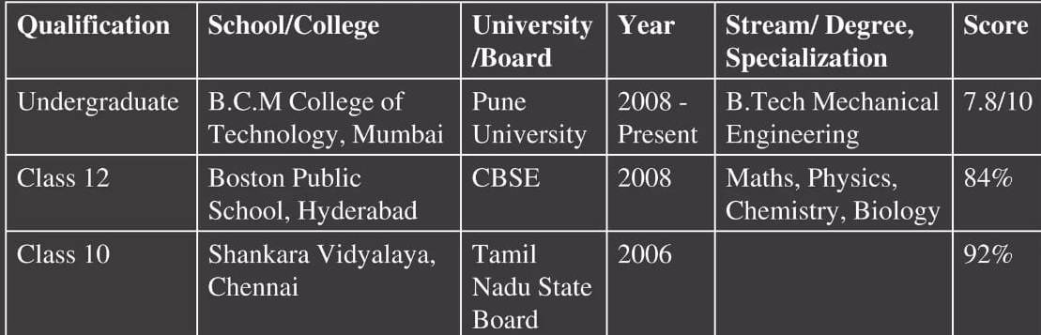
Example:-

Slide 19
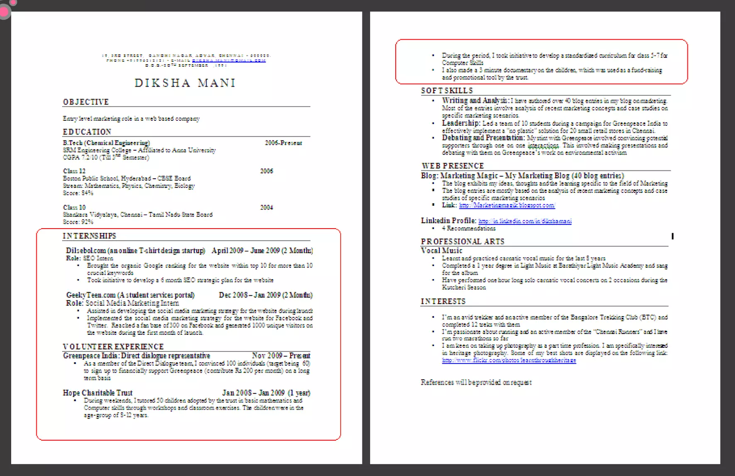

Slide 20
STEP 5 PROJECTS, INTERNSHIPS
Guidelines
You can include the following headings - Title/project name, role, Company/Organization Name, 1-2 line description (brief and specific) time period.
Time period is a must.
The entries under each heading must be in a reverse-chronological order.
Be very specific on what you've accomplished. Add numbers and tangible /factual results where ever possible
Examples :-
Academic Project: Model recycling system to treat Kitchen wastes (Jan 2008-April 2008)
Designed a model Liquid waste recycling system to treat and completely re- use the liquid wastes from the college kitchens for irrigation in the nearby agricultural land. Volume: 10000 lit/day The college has presently implemented this model on a small scale. This will be scaled up on successful operation for one year.

Slide 21
STEP 5 PROJECTS, INTERNSHIPS
Examples (Continued...)
The Hindu - Reporter Intern April 2008-May 2008 (2Months) As a reporter for Hindu's daily supplementary "Metro Plus", I received 5 bylines for the articles I contributed in the technology section. I also assisted the ideation team for the daily selection of articles to be published.
Greenpeace India: Direct dialogue representative Feb 2009-May 2009 (3 Months)
As a member of the Direct Dialogue team, I convinced 100 individuals (target being 60) to sign up to financially support Greenpeace (contribute 200 Rs a month) on a long term basis
The pitch to the potential supporters was through a one on one interaction with them, which tested my presentation skills and my ability to debate with them.

Slide 22
STEP 5 PROJECTS, INTERNSHIPS
Do Not
Do Not write generic statements. It does not give the employer a clear picture of the work you have done. Thus, the employer would assume you have done an internship just for the certificate
Here is a some bad examples: I worked for Hindu as in the technology division and learnt tremendously. I also contributed quality articles and assisted with ideas.
1 Volunteered for Greenpeace as a direct dialogue representative and achieved targets.

Slide 23
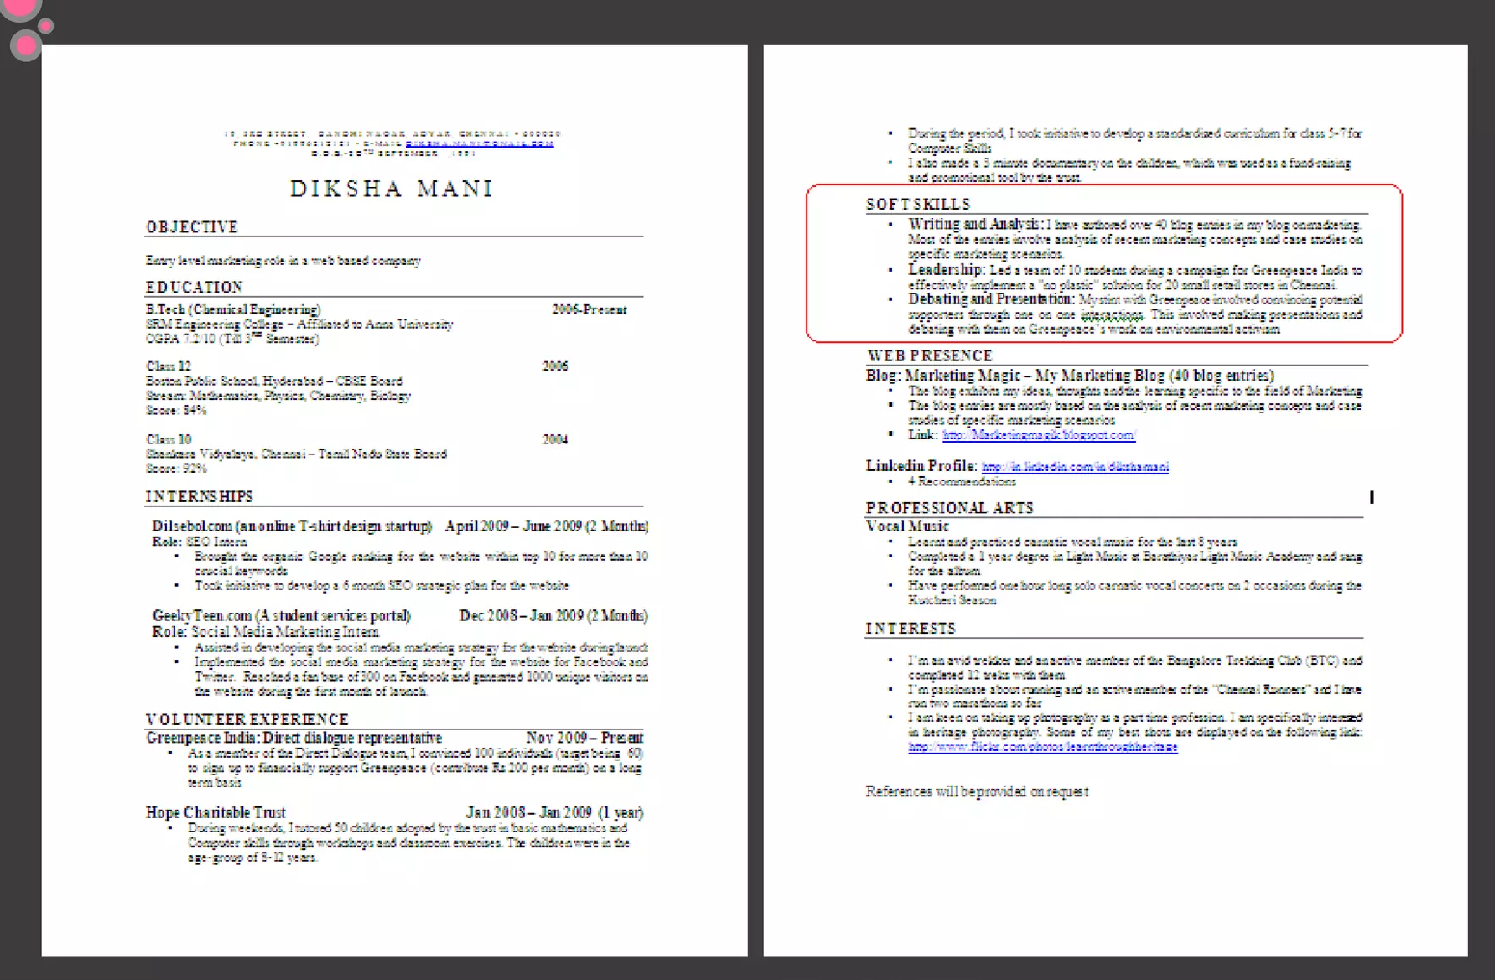

Slide 24
skills
In the previous section, you wrote about what you had DONE. In this section, you will be writing about what you have LEARNT through whatever you have done in the past.
Headings on Resume
You can have multiple headings under "Skills". Common headings that you can include are: 1.Soft Skills: Must include 2.Core/Occupational Skills: Optional. Include if you possess any core skills. 3.IT Skills: Optional. Advisable to include this if you are applying for IT/Software related roles.
Purpose
Soft Skills: To showcase your personality traits
Core Skills: These are skills you possess relevant to the role you are applying for (Occupational skills)

Slide 25
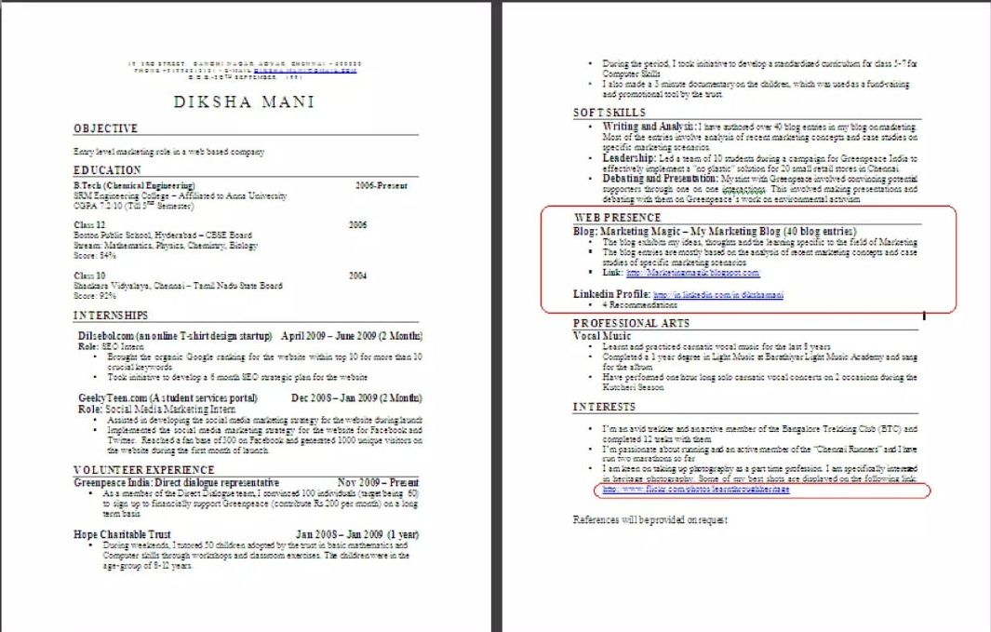

Slide 26
WEB PRESENCE
In the Web 2.0 era the world has access to "you" on the web. If you have good things to display about yourself on the web, it's a great idea to do that. Do you have a great LinkedIn profile? A meaningful blog or a website? Are you into professional photography and have displayed your photos on Flickr? Go ahead and showcase them on your resume and it'll definitely give you an edge when an employer screens it.
Purpose
Lets the employer know you're keeping up with the trend.
Portrayal of meaningful work/initiatives through web links adds value to your profile
Guidelines
Linkedin: as mentioned in example
Blog, Website: Title, description and link
Flickr, youtube, designs, ete: Give the link in the respective section

Slide 27
Guidelines
Make sure that any of the links that you provide are professional and do not have content may turn off the employer.
Examples
My Linkedin Profile: Imp://in.linkedin.com/in/rahulprabhakarfinkedin (4 Recommendations)
My Blog: Marketing Magic (14 Blog Entries)
This dedicated to my ideas, thoughts and the learning in Marketing. I have been updating my blog since Jun 2008
Link: httm/Marketingmagik.blogNTEL SSUN
Tip If you don't already have a profile on LinkedIn, go create one and get good recommendation on it.
Do Not
DO NOT add your Orkut, Facebook, Twitter or other social networking accounts on your resume.
That is the last thing your employer would want to see

Slide 28
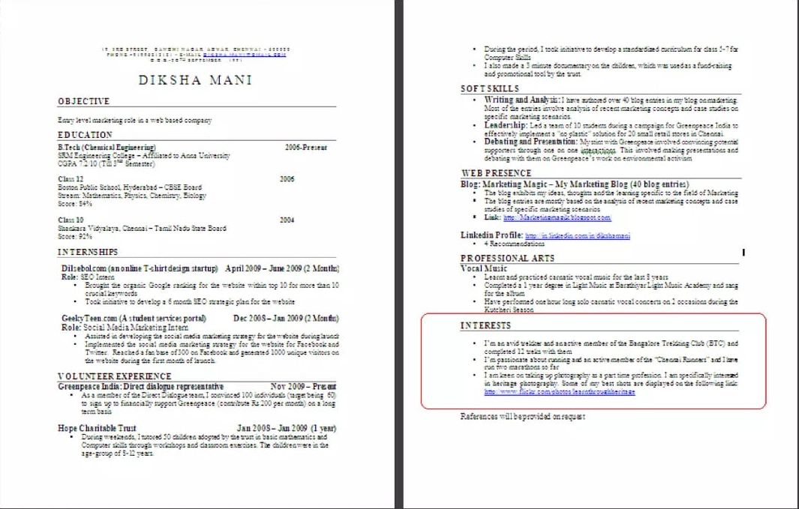

Slide 29
INTERESTS
You're almost done! This is the last section of you're resume. Carefully choose which of your interests you want to showcase on your resume so that they make your life seem meaningful.
Heading on Resume: Interests
Purpose
The interests you showease speaks about your character.
These interests frequently come up as a topic of discussions during the interviews, so wisely choose what to display.
Guidelines
List interests which are meaningful and display some learning Support the interest you have listed with a crisp point.
Make the points specific and tangible.

Slide 30
INTERESTS
Examples
I'm an avid trekker and an active member of the Bangalore Trekking Club (BTC) and completed 12 treks with them
I'm passionate about running and an active member of the "Chennai Runners" and I have run two marathons so far
Do Not
Do Not just list a random cluster of interests like: Adventure, guitar, reading, environment
Never include interests such as partying, watching movies, etc. They create a wrong impression.

Slide 31
Interview Skills
What Are Interview Skills?
The ability to communicate effectively, present your strengths, and demonstrate your fit for a role during a structured conversation.
These skills help interviewers assess both technical qualifications and cultural fit.
Why They Matter?
First Impressions: How you present yourself in an interview can influence whether or not you move forward in the process.
Assessment of Fit: The interview is a two-way street. It allows both you and the employer to assess if you’re the right fit.
Confidence & Professionalism: Demonstrating professionalism and confidence will make you stand out as a strong candidate.

Slide 32
Key Interview Skills
Preparation:
Research the Company: Understand the company’s mission, values, products, and services.
Example: "I see that your company values innovation, which resonates with me because I recently led a project that introduced a new software tool that increased efficiency by 20%.“
Know Your Resume: Be ready to discuss each experience in detail and explain the skills you gained.
Anticipate Questions: Practice responses to common questions (e.g., strengths, weaknesses, and experiences) and behavioral questions using the STAR method.

Slide 33
Communication Skills:
Active Listening: Show that you're paying attention by nodding, asking clarifying questions, or reflecting on the conversation.
Clear, Concise Responses: Avoid rambling and make sure your responses are tailored to the question.
Non-verbal Communication: Maintain good posture, make eye contact, and smile. These body language cues convey confidence and engagement.
Confidence:
Speak with Assurance: Use a calm and clear tone. Avoid filler words like "um" or "like."
Managing Nervousness: Practice relaxation techniques (deep breathing, visualization) before the interview.
Own Your Achievements: Be comfortable talking about your skills and successes without sounding boastful.

Slide 34
Behavioral Questions (STAR Method):
Situation: Describe the situation you were in.
Task: Explain the task you had to accomplish.
Action: Discuss the steps you took to address the task.
Result: Share the outcome and what you learned from the experience.
Example Question: "Tell me about a time you solved a challenging problem at work."
Closing the Interview:
Ask Questions: Show your interest in the company and role by asking thoughtful questions.
Example: "Can you tell me more about the team I would be working with?"
Express Gratitude: Thank the interviewer for their time and reiterate your interest in the position.

Slide 35
Common Interview Questions & How to Answer
Tell me about yourself:
Prepare a 1-2 minute summary that includes your background, key accomplishments, and why you’re excited about the opportunity.
Example: "I have 5 years of experience in project management, where I’ve successfully led cross-functional teams to deliver high-impact solutions on time and under budget. I’m passionate about working in a collaborative environment and am excited about the opportunity to bring my skills to your company."
Why do you want to work here?
Align your values with the company’s mission and demonstrate knowledge about their culture.
Example: "I admire your company's commitment to sustainability and innovation, which aligns perfectly with my passion for creating environmentally conscious solutions."

Slide 36
What are your strengths and weaknesses?
Be honest, but focus on a weakness you're actively working to improve.
Example: "One of my weaknesses has been delegating tasks, as I tend to want to control every detail. However, I’ve been working on building trust with my team and providing more autonomy to them, which has improved our collaboration."
Where do you see yourself in 5 years?
Show that you’re motivated, but also demonstrate alignment with the company’s growth.
Example: "In 5 years, I see myself taking on greater leadership responsibilities, ideally managing a team of like-minded professionals in a company that values innovation and growth."

Slide 37
Personal Branding
What is Personal Branding?
Definition:
Personal branding is the process of developing and managing your professional identity.
It’s how you present yourself to the world, how people perceive you, and the reputation you build over time.
Why Personal Branding Matters?
Differentiation: In a competitive job market, your personal brand makes you stand out.
Authenticity: It allows you to showcase what makes you unique—your skills, values, and passions.
Trust & Influence: A well-crafted personal brand creates credibility and authority in your field.

Slide 38
Key Elements of Personal Branding:
Reputation: What others think of you based on your actions, consistency, and contributions.
Values: Your principles and ethics guide your behavior, decisions, and interactions.
Skills & Expertise: How you apply your talents and knowledge in your career.
Online Presence: Social media profiles, personal website, LinkedIn, etc.

Slide 39
Steps to Building Your Personal Brand
Self-Assessment:
Identify your strengths, values, and passions.
Consider the traits you want people to associate with you. (e.g., innovative, dependable, approachable)
Reflect on your achievements and experiences to shape your narrative.
Define Your Brand Message:
Elevator Pitch: Create a concise, compelling statement that explains who you are, what you do, and what sets you apart.
Example: "I help companies streamline their digital marketing strategies by combining data analytics with creative content."

Slide 40
Consistency Across Platforms:
Ensure your online presence (LinkedIn, personal website, etc.) reflects your professional persona.
Maintain consistency in your messaging, imagery, and tone across social media profiles.
Networking & Relationships:
Build a network of professionals who align with your brand values and can amplify your reputation.
Attend industry events, engage on LinkedIn, and seek out mentorship opportunities.
Continuous Improvement:
Stay current in your field by learning new skills and keeping up with trends.
Continuously refine your brand based on feedback and new experiences.

Slide 41
Online Presence & Social Media
LinkedIn: Key components of an effective LinkedIn profile
Social Media Presence: Ensuring your online presence aligns with your brand
Tips for curating your personal brand online (personal blog, portfolio, etc.)

